Slide 1







ASAP
Anomaly Screening Applying Pseudo-wells
Alessandro Amato del Monte Per Avseth Jostein Herredsvela Anders Draege
Lucy MacGregor Lukas Mosser Sandeep Shelke
FORCE Hackathon: 18th-19th September 2018
Notes:
Note: background of team.

Slide 2
ASAP workflow
Input: well data
Generate pseudo wells
Generate synthetic seismic
Seismic data
Goal:
Develop an efficient workflow for seismic data analysis using deep learning.
Benefits
Allows on-the-fly integration of geological knowledge during the quantitative analysis.
Uses more information from the seismic trace (amplitude and waveform).
Pseudo-wells allow intuitive understanding of the cluster meta-space.
Unsupervised seismic clustering
Comparison/calibration
FORCE Hackathon: 18th-19th September 2018

Slide 3
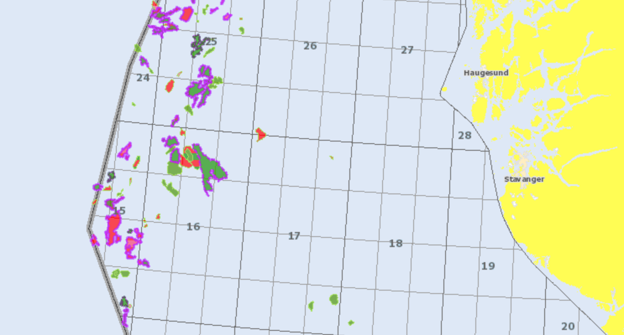
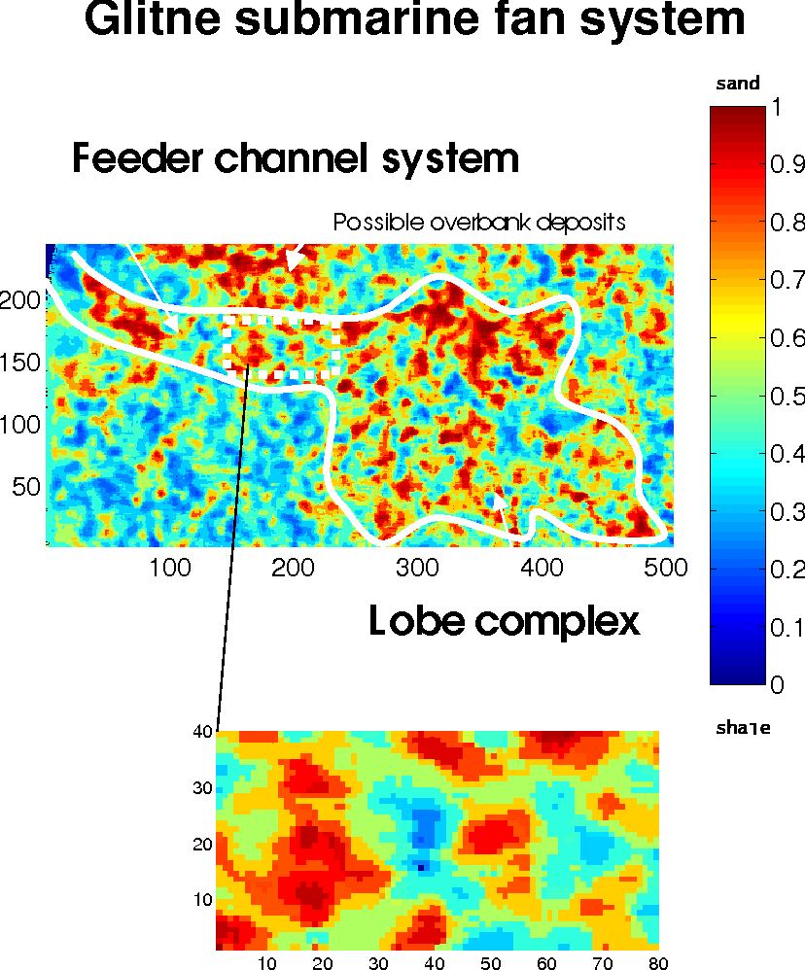
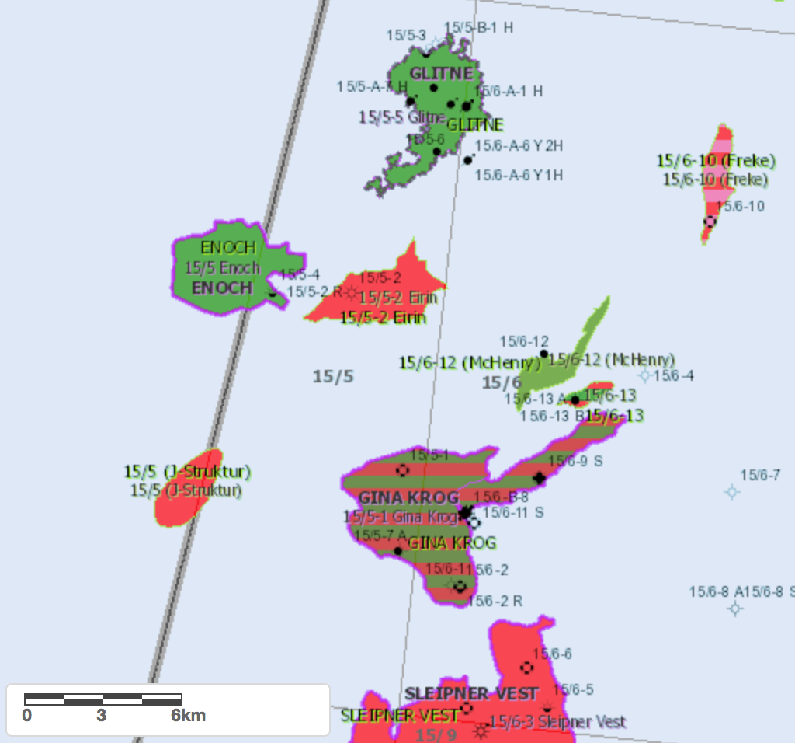
Data: Glitne field
Probability of sand – Glitne submarine fan system
Wells: 15/5-3, 15/5-5, 15/5-6
Seismic: Pre-stack (1995 vintage)
Caers, Avseth & Mukerji (2001)
FORCE Hackathon: 18th-19th September 2018

Slide 4
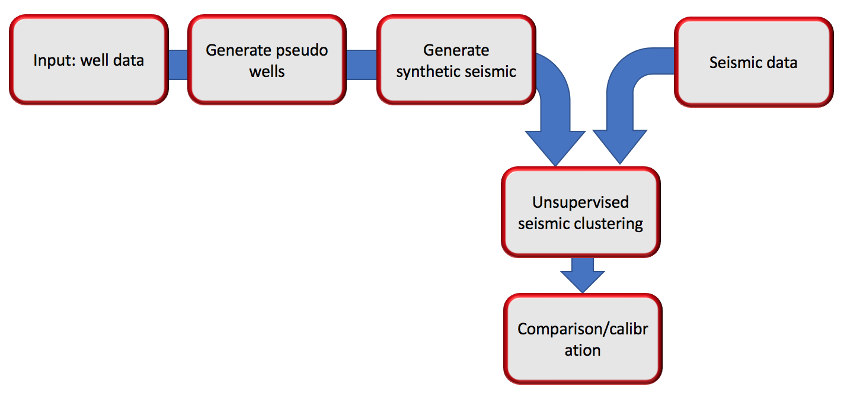
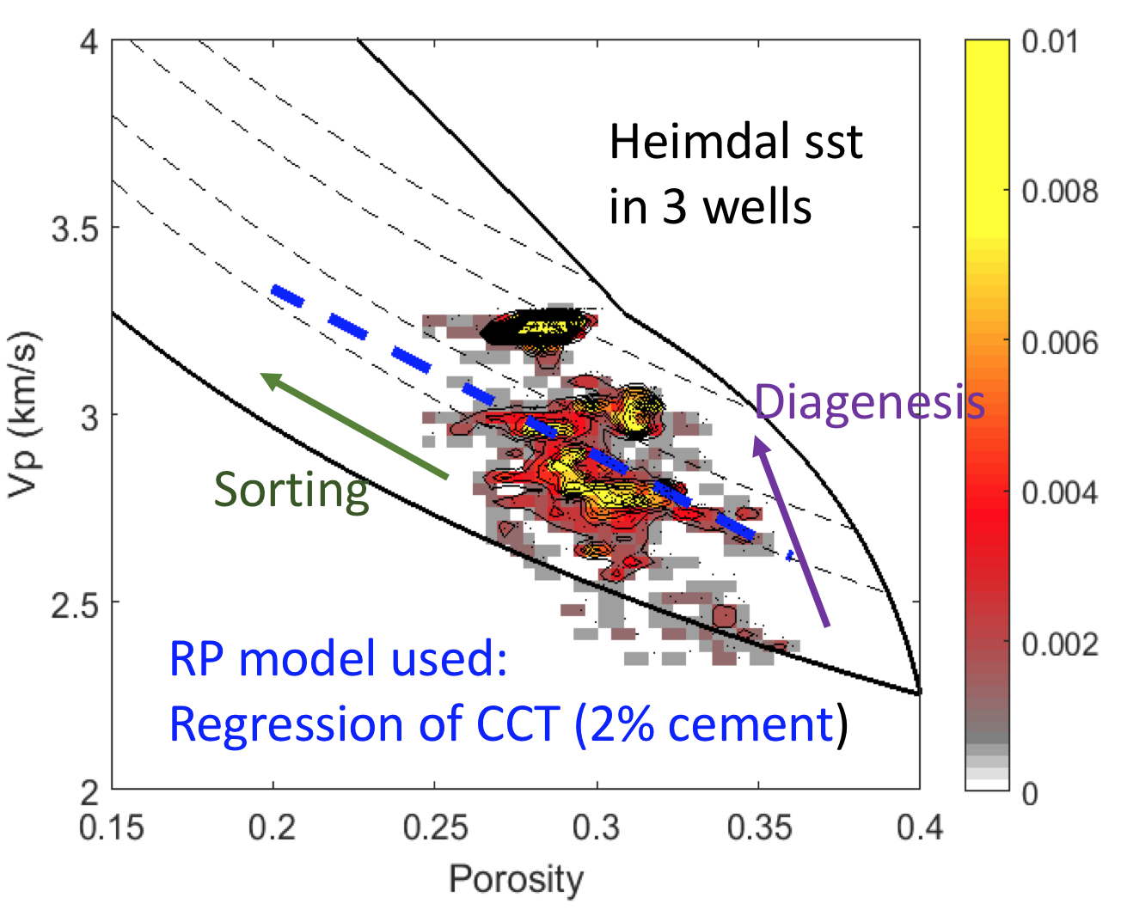
Generating pseudo-wells
Generated a total of 240 based on three wells (used 80 wells)
Linearised model for porosity and saturation
Property | Minimum | Maximum | Step
Oil saturation | 0 | 1 | 0.25
Porosity | 20% | 5% | 35%
Thickness | 0 | 60m | 20m
FORCE Hackathon: 18th-19th September 2018
Notes:
Used 80 wells.
Open well log and pre-stack seismic data.

Slide 5
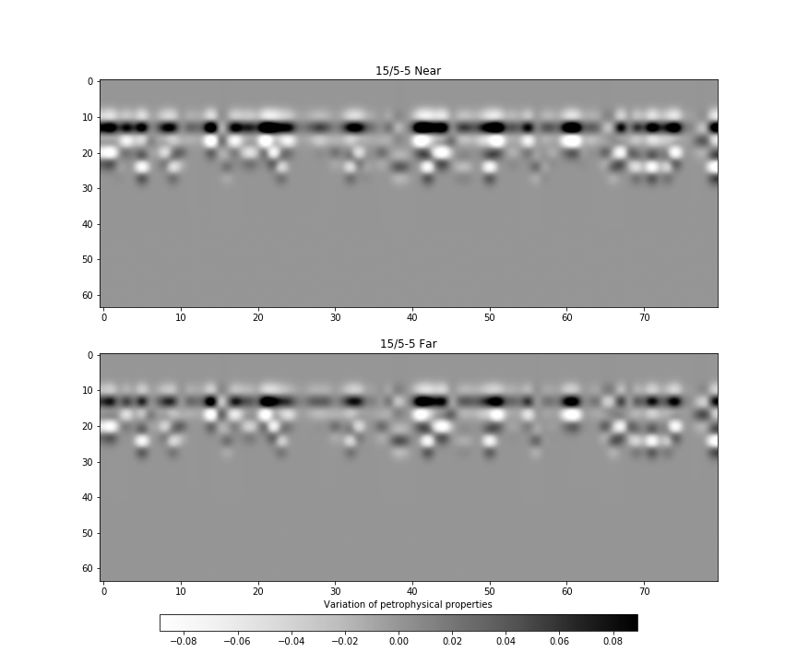
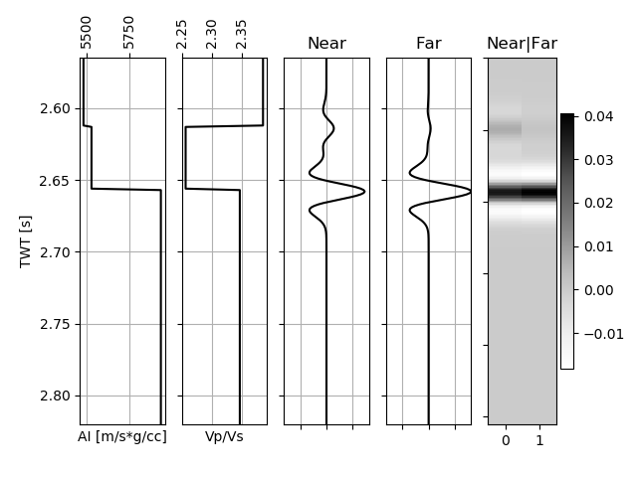
Generating synthetic seismic
Seismic data generated with a 30Hz Ricker wavelet
Brine
Varying properties
FORCE Hackathon: 18th-19th September 2018

Slide 6
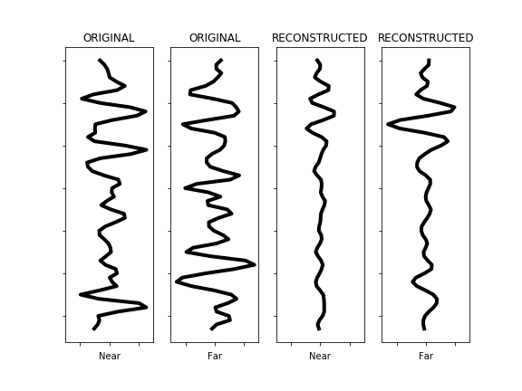
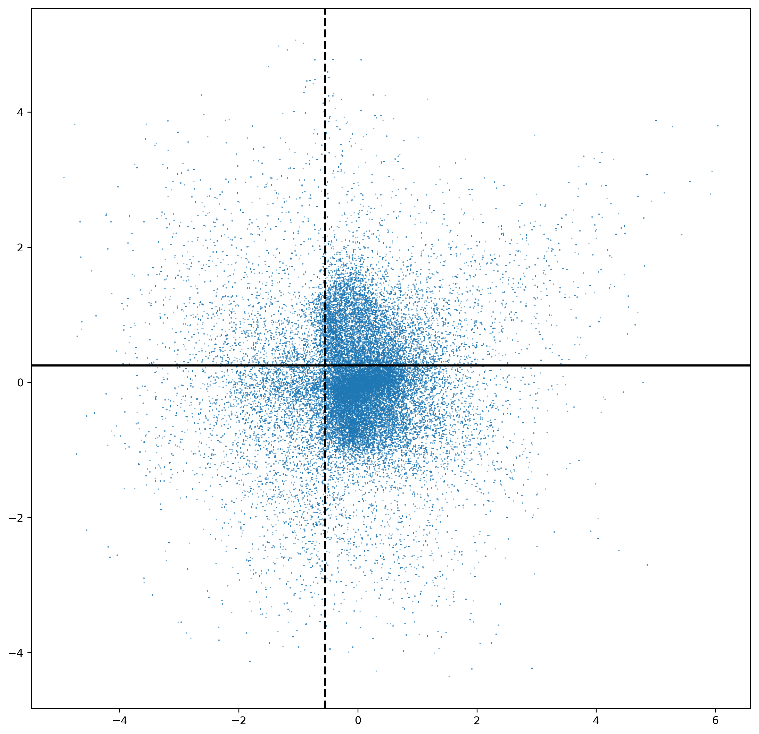
Unsupervised clustering of seismic data
Tested 3 approaches:
TSNE/UMAP: worked well, but no spatial correlation
Variational auto-encoder: spatial correlation and reduces noise in the data.
Input seismic
Encoder space
Reconstructed seismic
Convolutional neural network
Convolutional neural network
FORCE Hackathon: 18th-19th September 2018

Slide 7
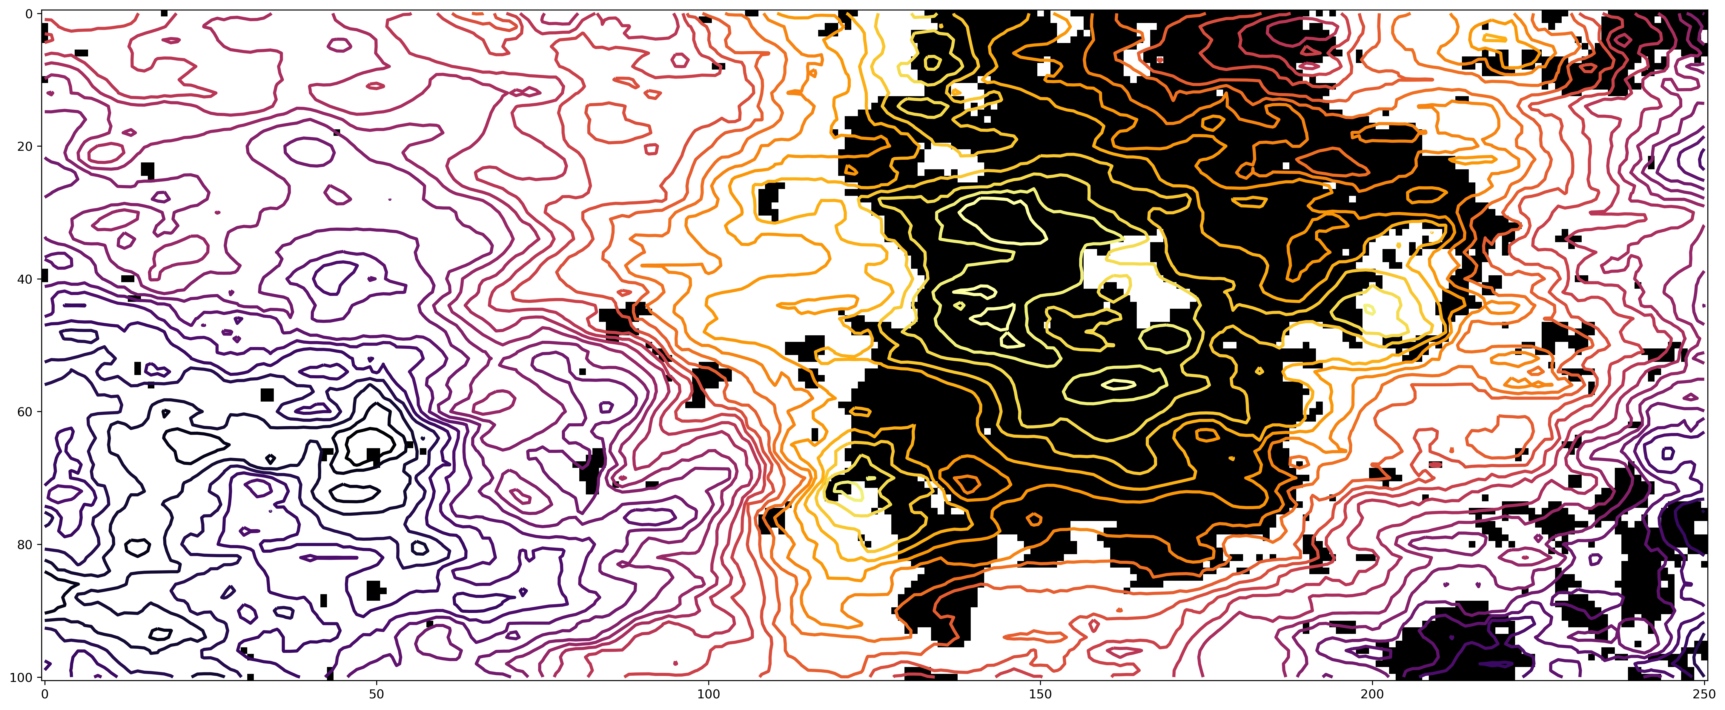
UMAP
Binary classification highlights the oil filled structure.
FORCE Hackathon: 18th-19th September 2018
Notes:
Well at 38 138

Slide 8
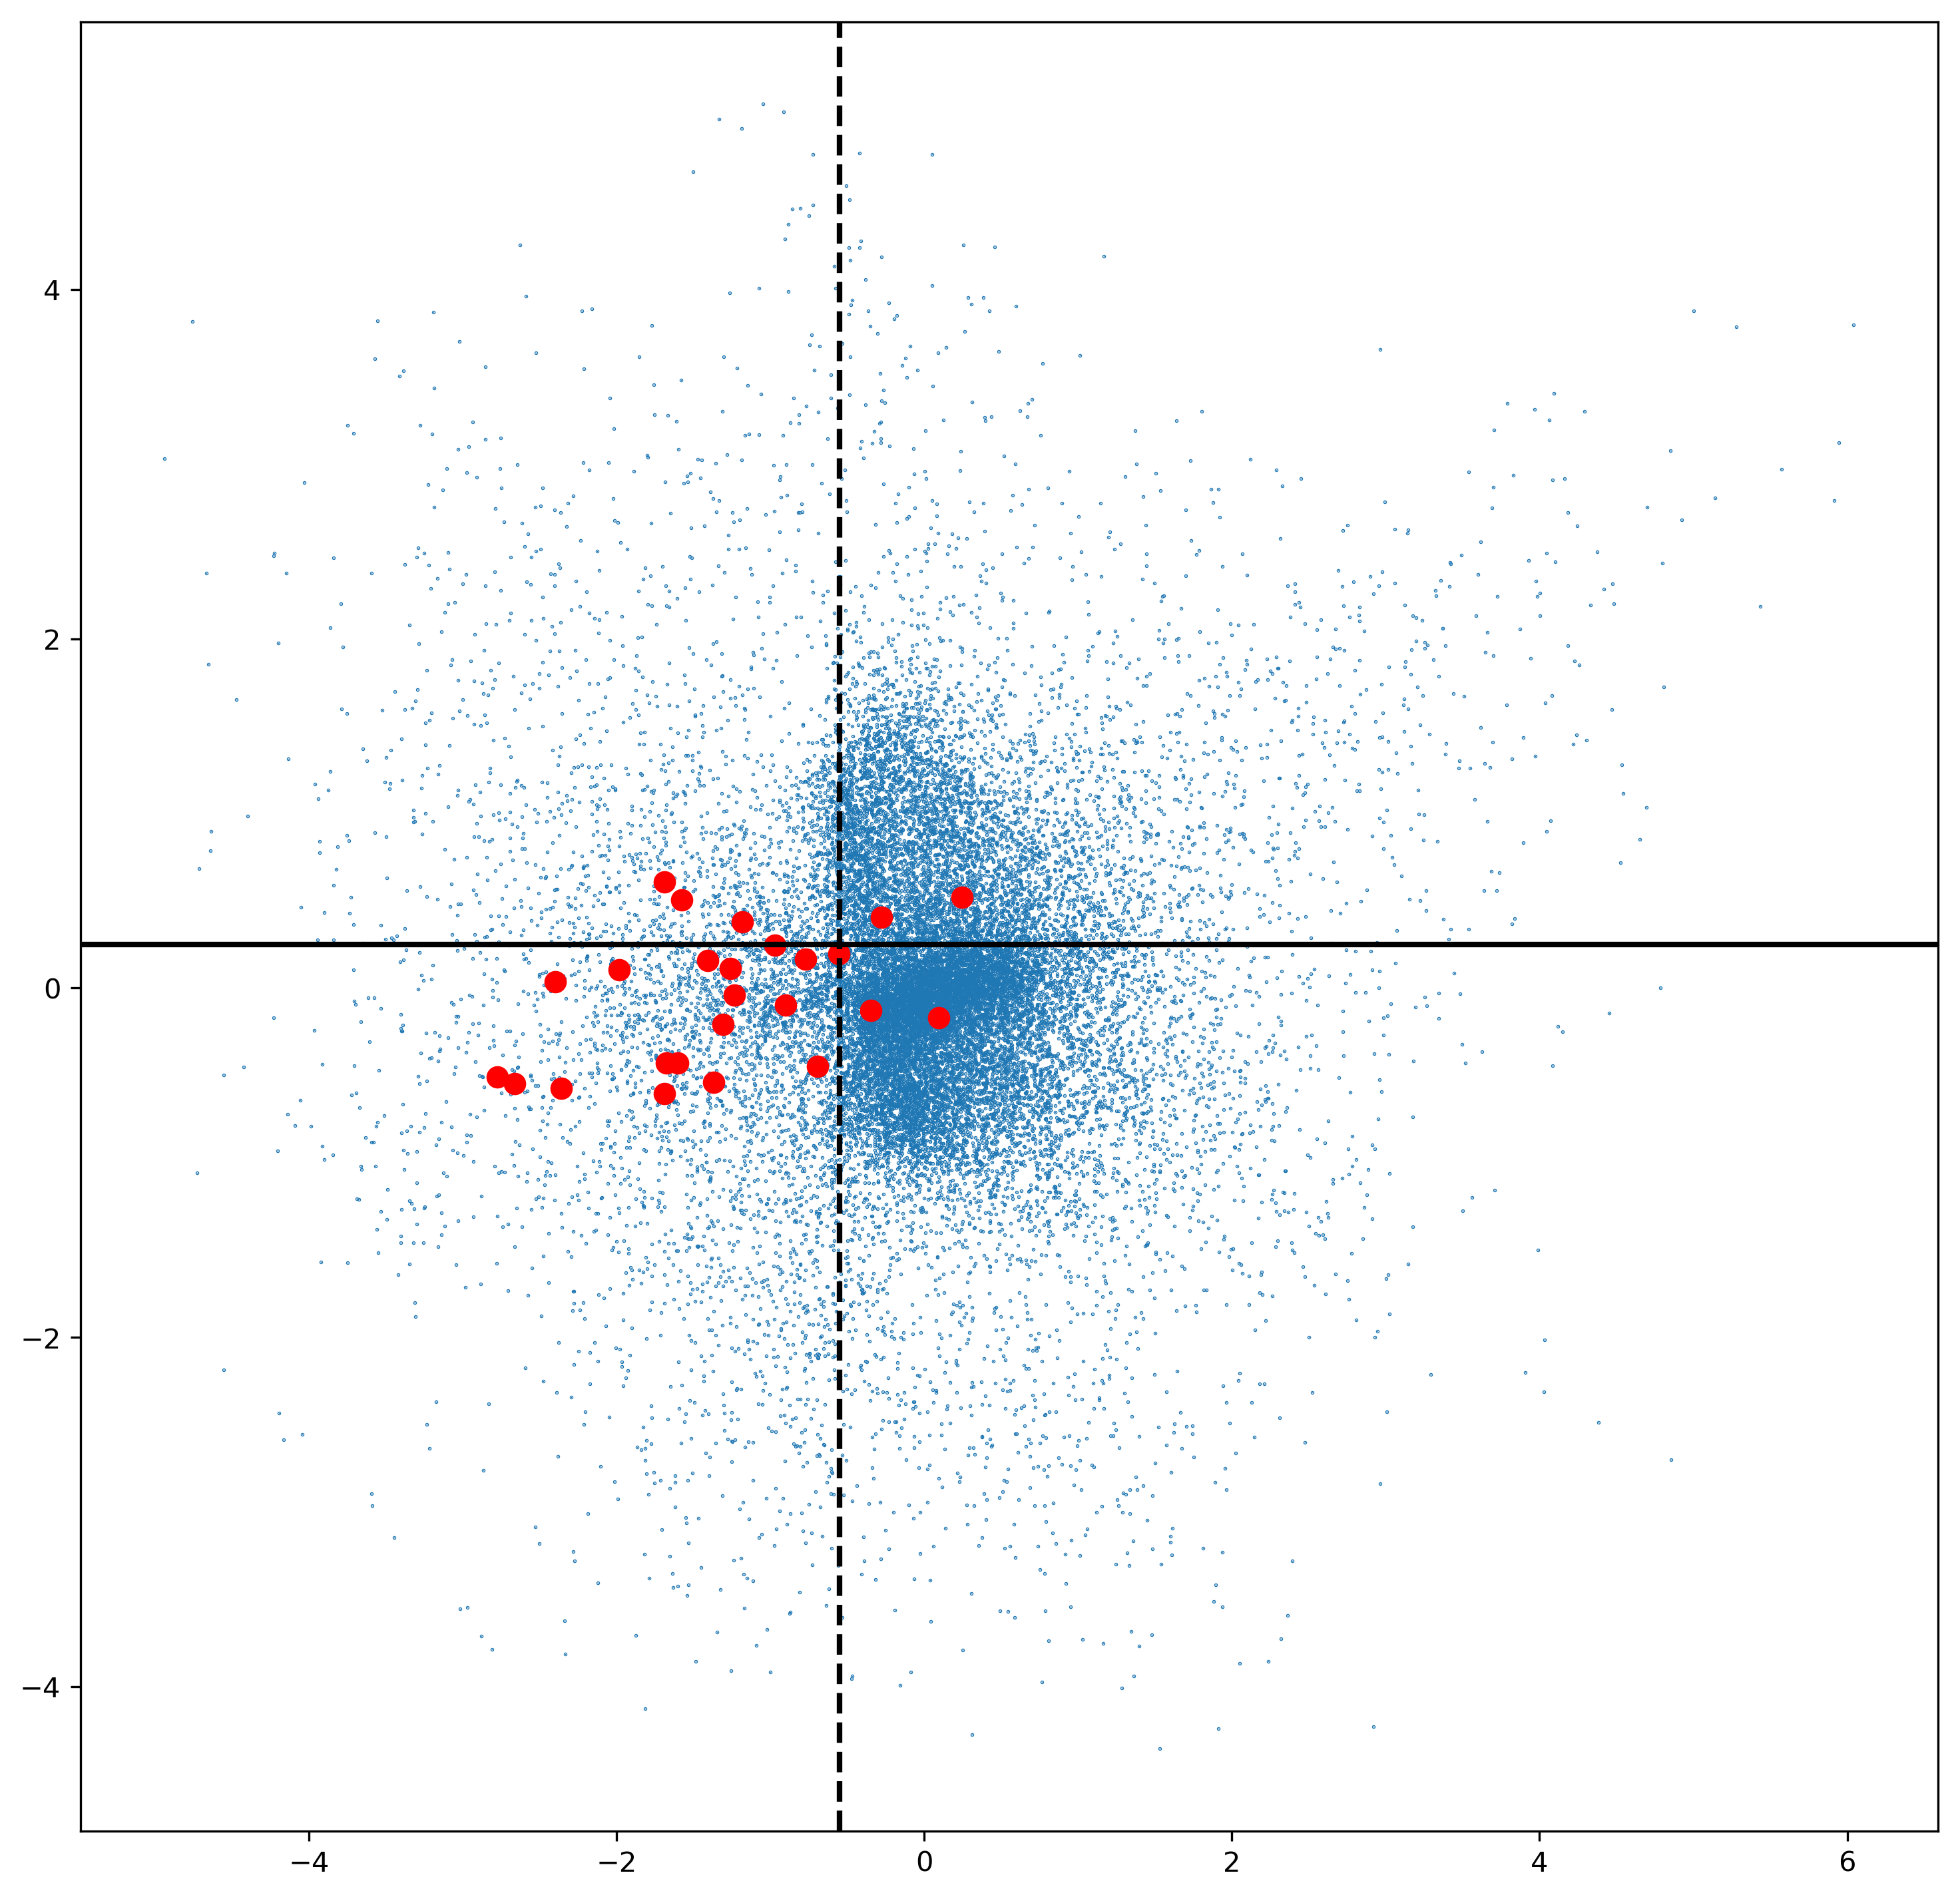
Variational auto-encoder
Hydrocarbon fluids
FORCE Hackathon: 18th-19th September 2018

Slide 9
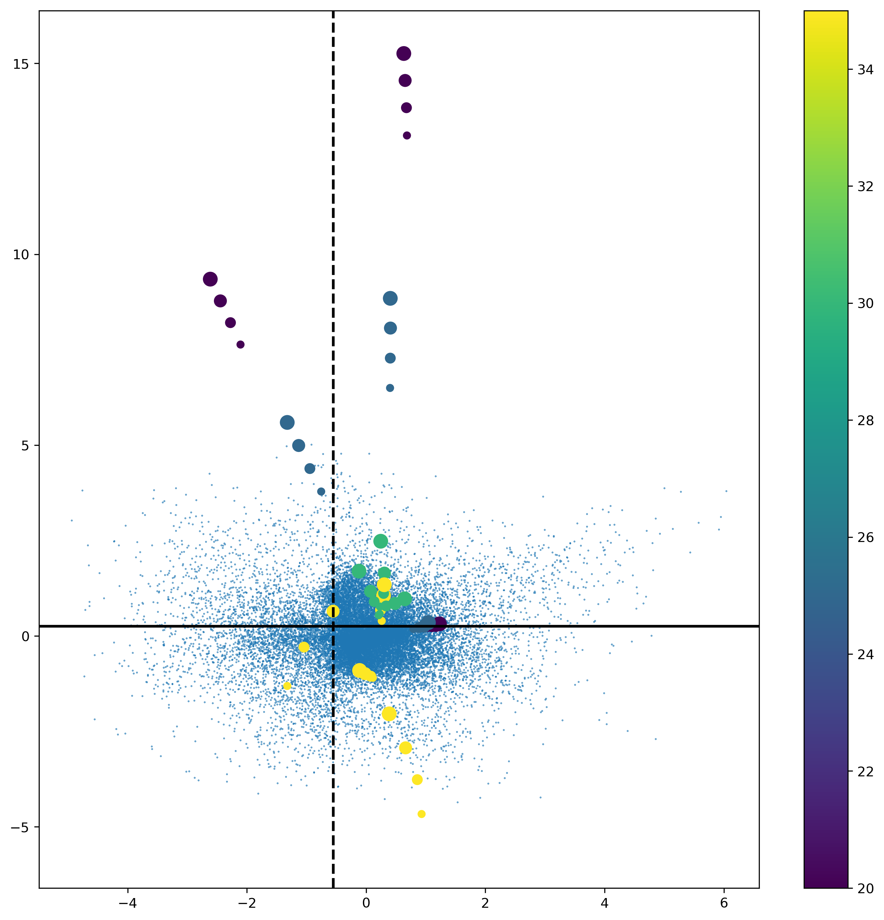
Unsupervised clustering of synthetic data
Stiff sands
Porosity
Hydrocarbon fluids
Non-reservoir
FORCE Hackathon: 18th-19th September 2018
Increasing symbol size = Increasing brine saturation

Slide 10
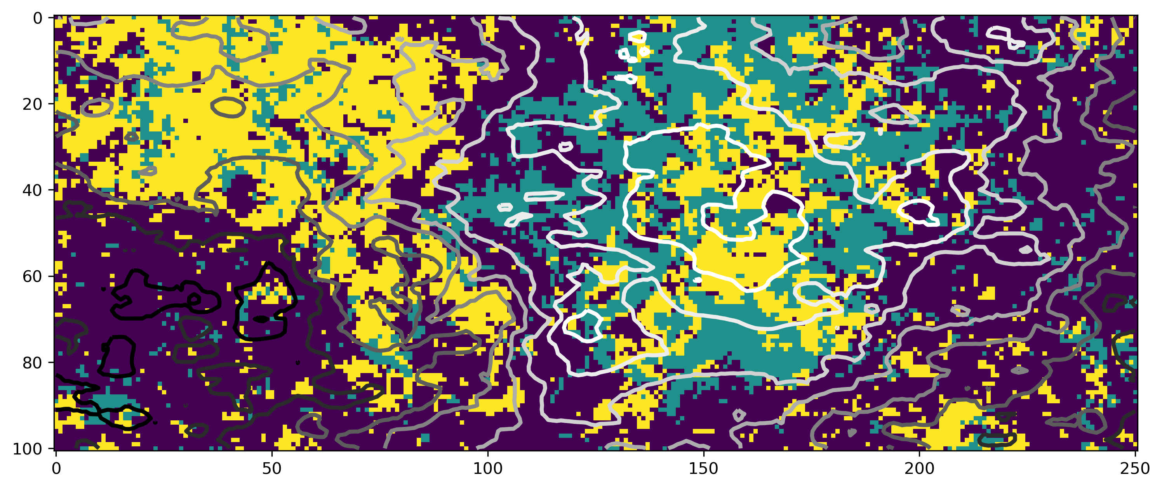
Variational auto-encoder
Map view of seismic: reservoir interval. Contours show structure.
Stiff sands
Hydrocarbon fluids
Non-reservoir
FORCE Hackathon: 18th-19th September 2018
Notes:
Well at 38 138

Slide 11
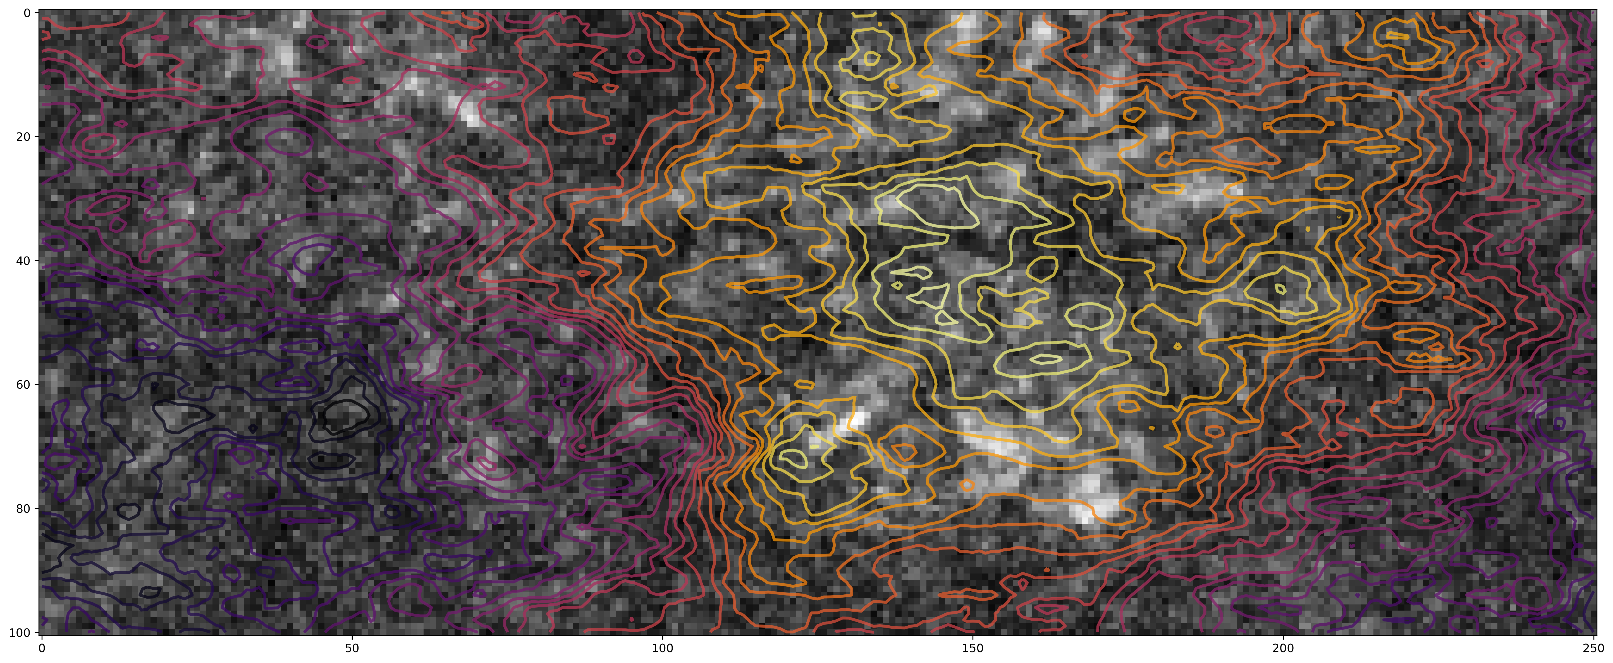
Calibration using fluid factor
Hydrocarbon fluids
FORCE Hackathon: 18th-19th September 2018

Slide 12
Summary
ASAP uses unsupervised clustering applied to real and synthetic data to rapidly assess reservoir properties.
What worked
Efficient clustering highlights lithology and fluids much faster than conventional QI workflows
Making use of all the information available in the seismic trace (waveform) – not just intercept/gradient/amplitude.
Geologically driven screening – more interaction with geologists early on in the process.
Things to try:
Pseudo-wells too blocky: finer scale pseudo-wells might improve the results.
Larger dataset of pseudo-wells incorporating target and background trends.
All code will be made available on GitHub
FORCE Hackathon: 18th-19th September 2018

Slide 13
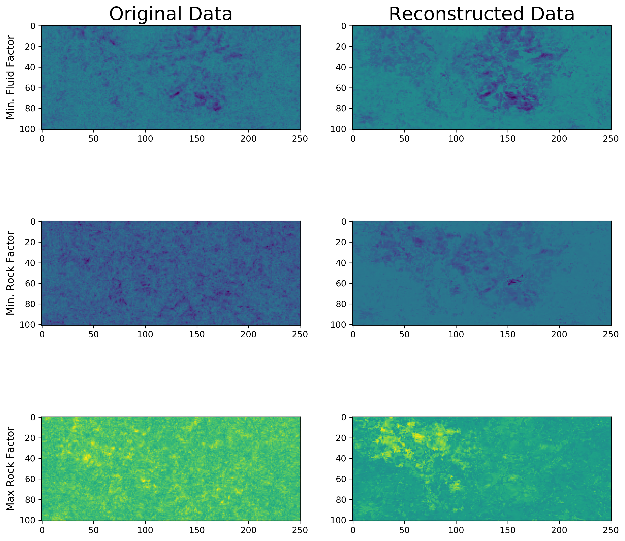
Fluid and rock factor
FORCE Hackathon: 18th-19th September 2018

